Slide 1
Turbidity Test of Water
By
Devansh Wadhwani – (64)
Diksha Utekar – (63)
D15A INFT

Slide 2
Project Summary
• Arduino-based system to measure water turbidity.
• Uses a turbidity sensor to display real-time readings.
• Useful for environmental monitoring and water quality.

Slide 3
Components Used
• Arduino UNO R3
• Turbidity Sensor (SEN0189)
• 16x2 LCD Display (with I2C)
• Jumper Wires
• USB Cable

Slide 4
Pin Connections - Turbidity Sensor
• VCC to 5V
• GND to GND
• Signal to A0

Slide 5
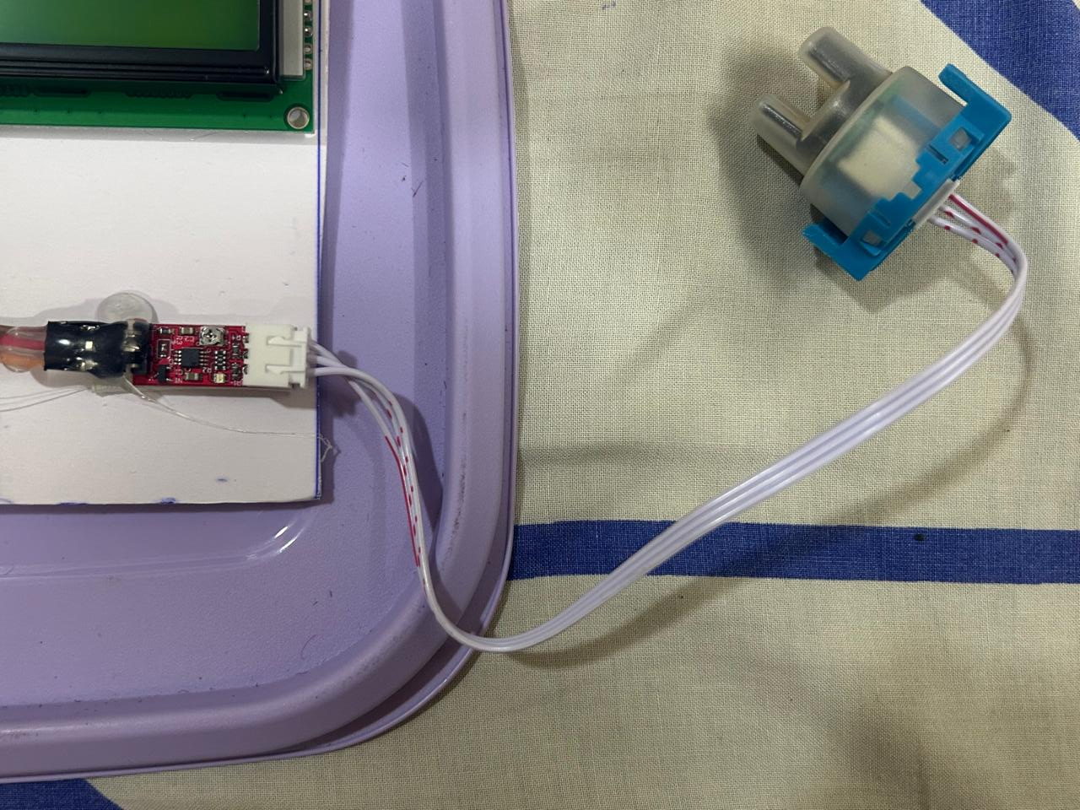

Slide 6
Pin Connections - LCD (I2C)
• VCC to 5V
• GND to GND
• SDA to A4
• SCL to A5

Slide 7
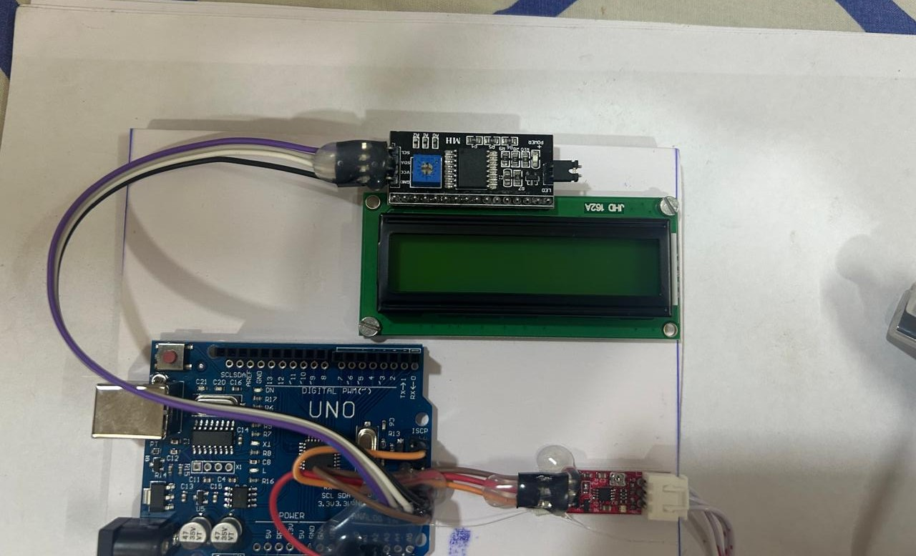

Slide 8
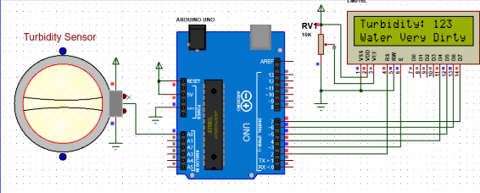
Circuit Diagram and Schematic

Slide 9
Procedure - TinkerCAD Simulation
• Simulate Arduino UNO and verify LCD.
• Connect turbidity sensor.
• Run sample codes.
• Display Turbidity on LCD.

Slide 10
Procedure - Physical Implementation
• Connect LCD and turbidity sensor.
• Upload and run code.
• Test with various water samples.
• Monitor LCD for turbidity readings.

Slide 11
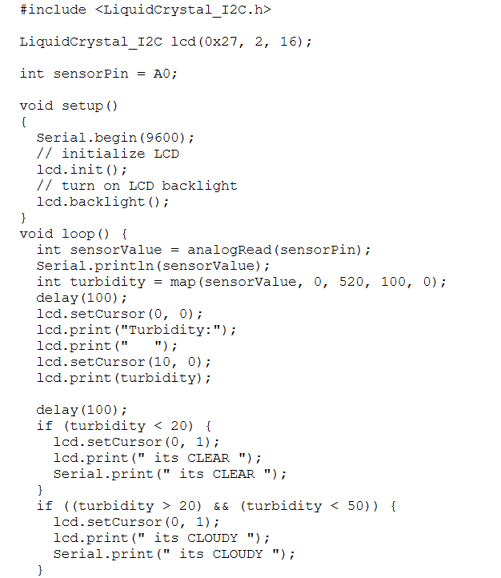
Arduino Code (Part 1)

Slide 12
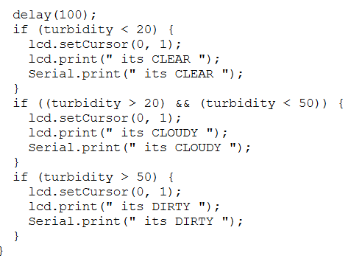
Arduino Code (Part 2)

Slide 13
Explanation of Code
• Initializes and sets up the LCD.
• Reads sensor's analog values.
• Judges the Purity of Water Sample
• Displays turbidity readings on LCD.

Slide 14
Applications
• River and lake pollution monitoring
• Industrial wastewater analysis
• Aquaculture
• Drinking water quality testing

Slide 15
Conclusion
• Learned sensor integration with Arduino.
• Displayed and interpreted turbidity levels.
• Built a practical environmental tool.

